Slide 1
Catapult Simulation Optimization
Group Members: Fall 2020, EE608

Slide 2
Problem
In 2024, NASA will land humans on the moon to explore the lunar surface in ways it has never been seen before. We believe we need to optimize old technologies to work for our needs today. Catapults are an ancient technology used in warfare. We want to optimize the catapult to be able to launch small probes the farthest possible distance on on the lunar surface to collect data. We will model the catapult and find the maximum possible projectile launch distance using the Karush-Kuhn-Tucker conditions.
Importance
Catapults can prove to be a very useful technology when exploring space. Catapults would give the astronauts the ability to launch many probes far distances in a short period of time. These probes could collect data and send it back to the lander to inform the crew of potential things they might want to investigate in person. The reason we chose catapults for this is because it is a reusable technology which could reduce costs and reduce waste on a spaceship.
Notes:
https://military.wikia.org/wiki/Catapult`

Slide 3
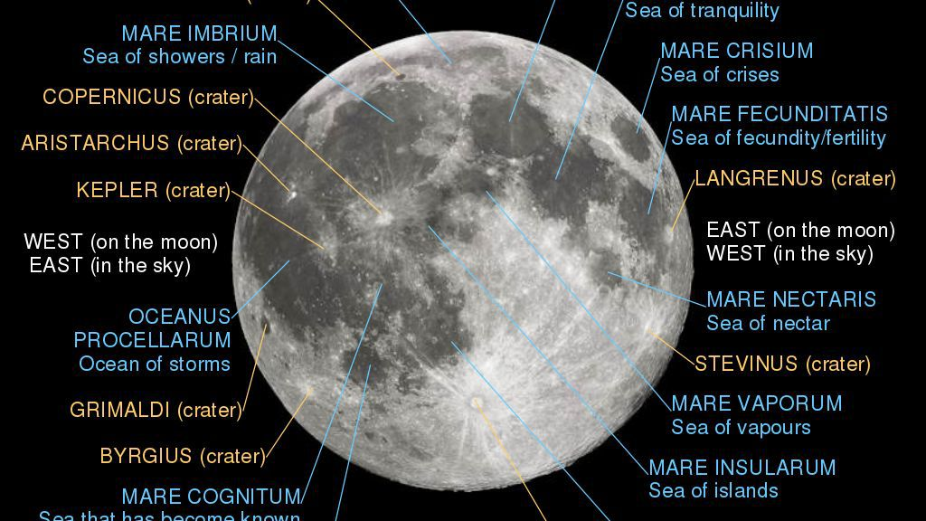
Current Approaches
Currently this problem does not have a solution as the mission to land on the moon isn’t set until 2024. We propose the use of a catapult to launch probes into craters due to it being a mechanical technology that is not prone to issues that non mechanical technology may have. The catapult is also cost effective. Due to the moon's atmosphere, it is a perfect place to study craters. Since technology has advanced since we last landed on the moon, having a catapult launch probes into and around the moon's craters can help up better understand the lunar surface in a shorter period of time, thanks to the catapult.
Notes:
https://sigmazone.com/catapult/

Slide 4
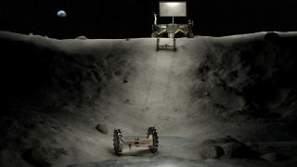
Innovation
Catapults are a very versatile technology that started as the most effective ancient weapon as they could be used to throw a projectile without the help of explosive devices. Through the optimization of catapults, they can now be used for things as big as launching aircrafts from small flight decks. We are interested in the possible use for catapults for reusable in-space technology. Using catapults for this use is better because it is something that can be used by man power alone, so there is less room for technical errors on the space mission.

Slide 5
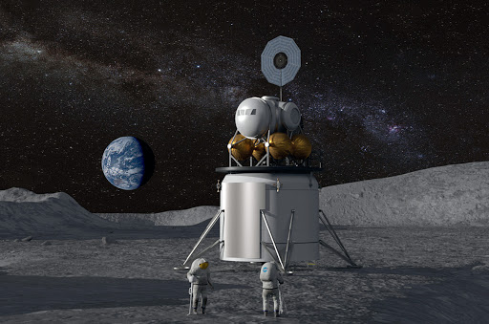


Audience
The customer in this situation would be NASA, SpaceX, or any other space agency interested in landing on another planetary body. The selling point is that the catapult is a cost effective, mechanical product. Although there are other probable ways to launch probes into craters from the surface of the moon, the catapult is an easy and true way of doing it. Similar to how catapults were the most effective technology in warfare in ancient history, catapults can see a new life in upcoming space exploration. Using a tried and true technology we have an easy way to quickly disperse probes long distances and gather information back to the lander. This will allow astronauts to quickly identify which craters and which areas of the lunar surface are worth their time to study and check out in person.

Slide 6
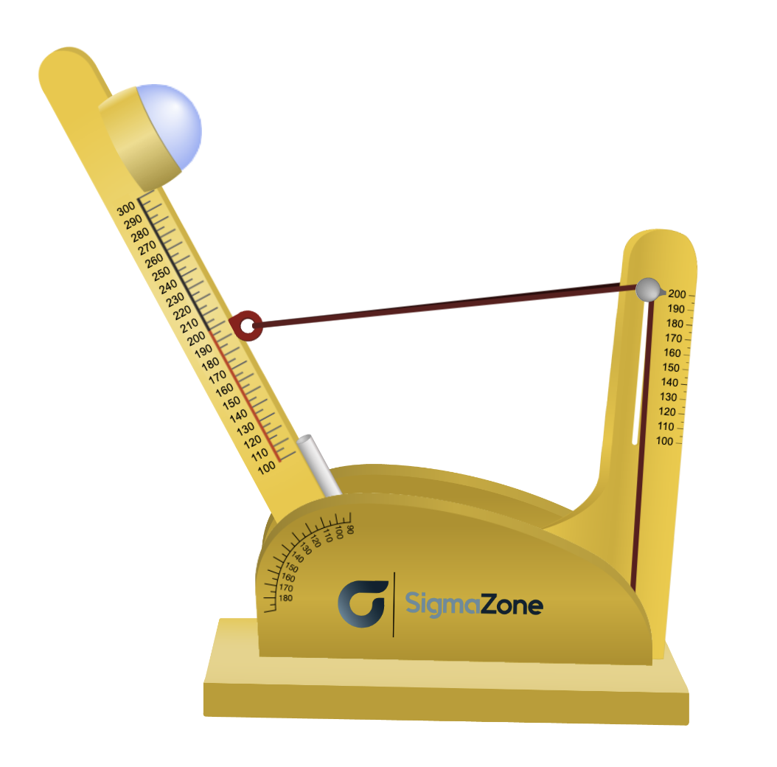
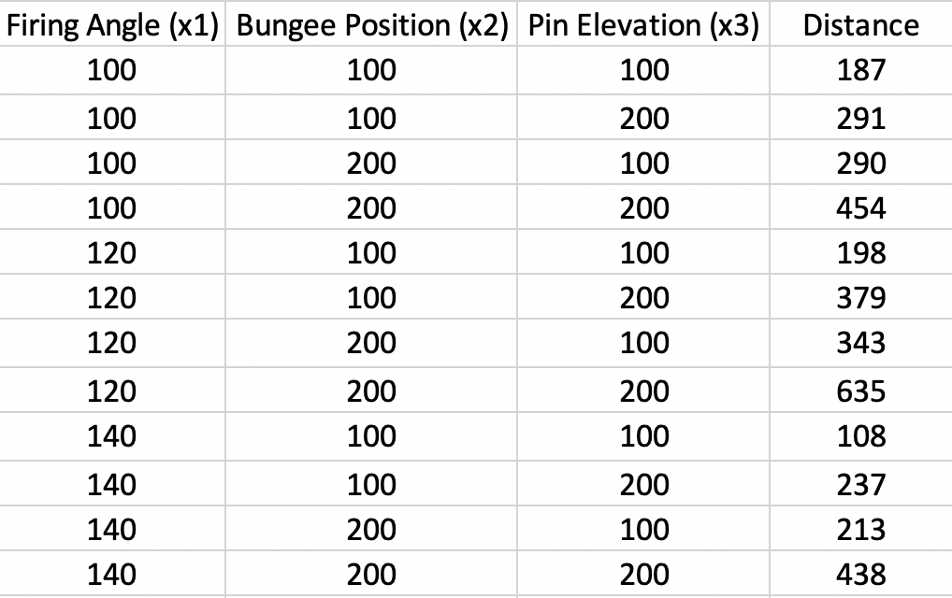
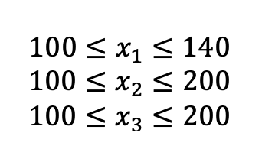
Optimization Model
Catapult simulation used
Data collected
Variable constraints

Slide 7
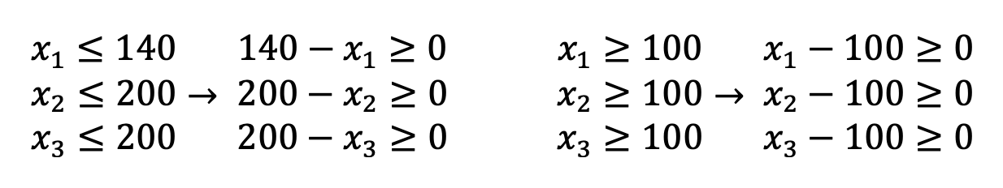
Optimization Model
Using Karush-Kuhn-Tucker conditions:
R-Squared value 0.94
Constraints for KKT

Slide 8
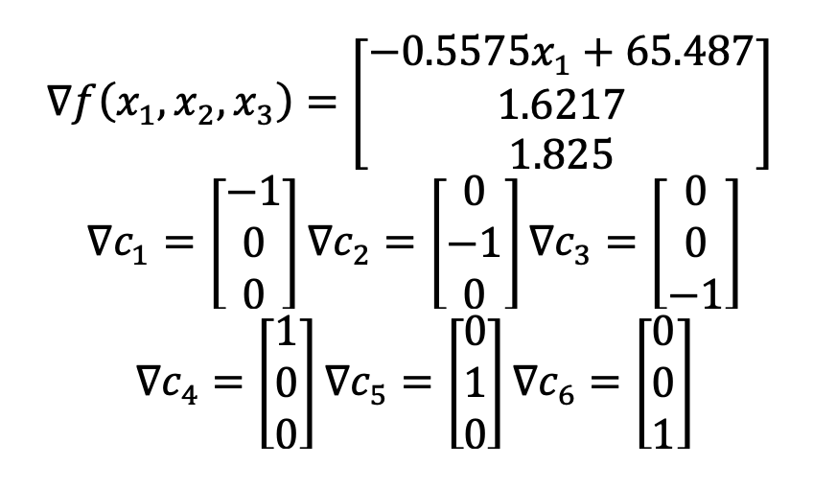
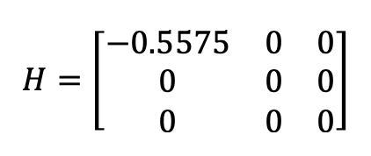
Proposed Solution
Applying KKT for maximization
Hessian Matrix
Negative semidefinite,
Thus concave

Slide 9
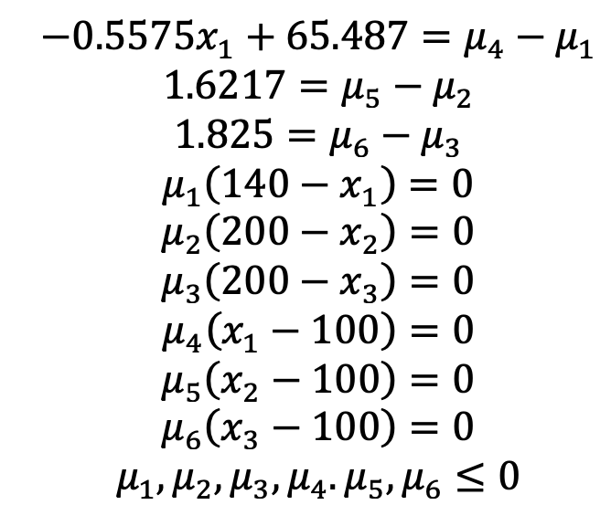
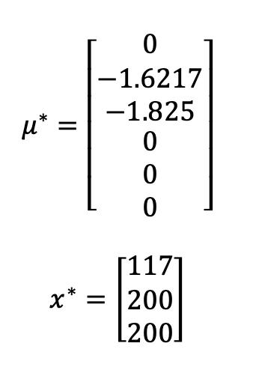
Proposed Solution
Applying KKT for maximization

Slide 10
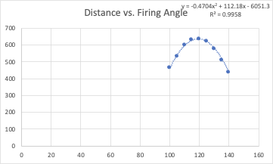
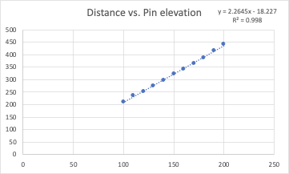
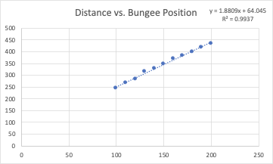
Validating Solution
Solution states:
Firing angle = 117
Bungee Position = 200
Pin Elevation = 200
Plots holding all other variables constant
to study the effect each variable alone has on distance
Notes:
Validating Solution (how did you test your solution is valid, e.g., tested using dataset, simulations, theoretical analysis, etc.)

Slide 11
Validating Solution
Firing angle - Quadratic behavior
Bungee position - Positive Linear behavior
Pin elevation - Positive Linear behavior
Optimal firing angle can be validated by finding the vertex of quadratic model.
Vertex = (119.2, 636.8)
Therefore optimal firing angle is around 119.2.
Optimal bungee position can be validated by Weissman Extreme value theorem.
Optimal pin elevation can be validated by Weissman Extreme value theorem.
Intervals are bounded and closed.
Therefore optimal bungee position and pin elevation are maximum, or 200.
Notes:
Validating Solution (how did you test your solution is valid, e.g., tested using dataset, simulations, theoretical analysis, etc.)

Slide 12
Key Insights
The solution and experimental data infer that there is a set of parameters that will result in the farthest possible launch distance in the range of acceptable parameters for the catapult.
In the range for firing angle, as the angle is increased the launch distance will increase until it hits it’s maximum distance point, then the launch distance will begin to decrease, similar to a parabolic shape. The solution suggests the optimal value is between the min and the max, at the vertex of this parabolic shape.
In the range for bungee position and pin elevation, the relationship between the parameter and launch distance is linear so the solution suggests to achieve maximum distance we must use the maximum setting.
Notes:
Key Insights (what does your solution mean for the problem?, what are the key observations you made from the solutions as applied to the problem?)

Slide 13
Major Conclusions
A mathematical model was successfully found by creating a table comprised of simulation trials and using MATLAB to calculate a non-linear model.
MATLAB model provided polynomial with R-Squared value of 0.94, so the predicted values are slightly off from the experimental values. The maximum distance calculated for our catapult is 562.81m. When applying the solution, a maximum launch distance was found to be 640m.
The results were as expected, since it can be seen where a maximum may be found by using the data table. The optimization helped in finding the exact values where a maximum can be found. When testing parameters surrounding the solution, only lower values were found. Thus proving the solution provides a true maximum distance.
Notes:
Major Conclusions (was your approach viable?, did you run into any difficulties such as infeasibility, numerical instability, unexpected results, insufficient or imbalanced datasets, etc.)

Slide 14
Suggestions for Improvement
If there had been more time to work on this project, the team could have been able to construct a working prototype of a catapult including more customization to the parameters. This could have included a greater range of possible parameter values or more input variables to study to create a more realistic model of the catapult.
For example, real world variables such as projectile weight, air resistance, and the effect of gravity on different planets could have been further studied for a more realistic and accurate catapult optimization model.
A larger dataset could have given us a more accurate mathematical model to work with.
If we wanted to find a very accurate solution to the optimization problem, a table with more data points could have enabled MATLAB to produce a more accurate non-linear model.
Notes:
Suggestions for Improvement (if you had more time and resources what would you have done to solve the problem?, e.g., considered a more realistic model, used a larger dataset, implemented a working prototype, launch a startup and become a billionaire!)

Slide 15
Thank you for listening
For source code please see the attachment

